Slide 1


Technical Analysis – Stocks vs Crypto
Group 3: Project 1
Raelyn Sangil (Project Lead), Kurt Cullerton, Ramon Lee, Parvinder Rakhra

Slide 2
Overview
The purpose of this project is to analyse the growth potential, if invested, in top 5 market cap stocks and / or crypto projects. This presents a detailed technical analysis of the performance of both asset class over last 5 year.
READMe
Notes:
Raelyn

Slide 3
Motivation and Summary
Motivation
Analyse better long term investment options
Analyse Associated Risks & Rewards
Analyse Volatility and Returns
How these asset classes have performed, in last 5 years?
Approach
Used APIs to pull stock and crypto data
Questions!
How volatile the investment could be during testing times?
Focused or optimised portfolio? i.e. an optimised mix
Imported various libraries to analyse and visualise performance
Identified trend and visualised historical price
Applied multiple models to predict future price and volatility
Analysed volatility from major macro economics factors and black-swan event(s)
Notes:
Parvinder

Slide 4
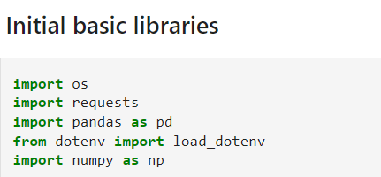
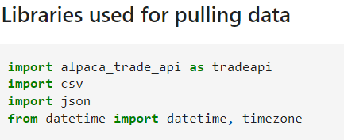
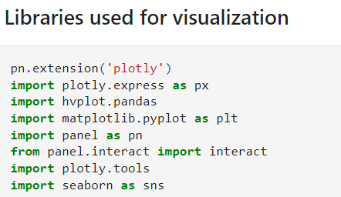
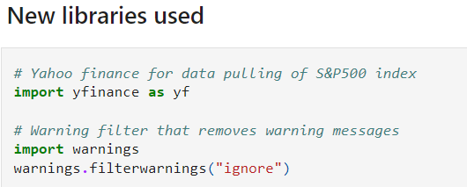
Libraries used
Basic Panda Libraries and dependencies
Alpaca libraries for pulling data
Libraries used for data visualisation and graphs
New Library to pull S&P 500 data and ignoring warning messages
Notes:
Kurt

Slide 5
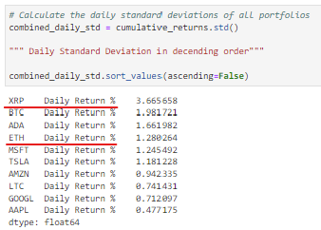
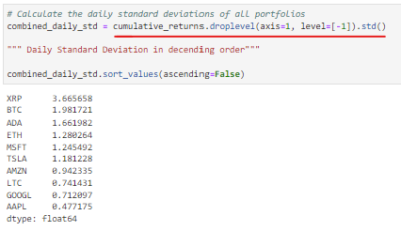
Data Cleanup & Exploration
Exploration & Clean-up
Problems & Insight
Interesting Findings
Used Alpaca API to get trading data
Yfinance API for S&P500 data
Used closing prices for analysis
Removed nulls, columns and headings and sorted data, where applicable
Fetching 5 years crypto data
Comparing 24/7 crypto trading data to 9/5 – 252 days stocks trading data
Inconsistencies between Crypto and Stock data structure
Fixing tickers, using .droplevel(axis, level)
Crypto market more volatile than stocks
Crypto reacts negatively to major macro economic factors eg: Covid
Long term perspective Crypto assets gave better returns
Notes:
Kurt

Slide 6
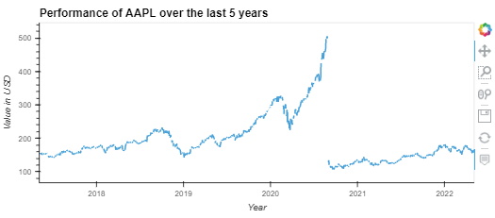
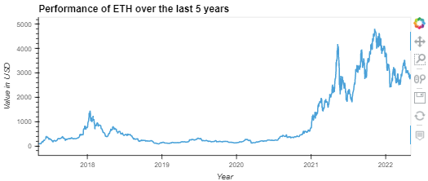
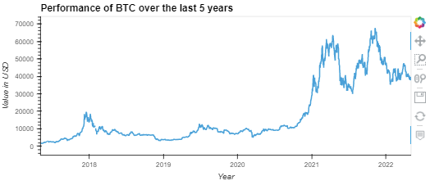
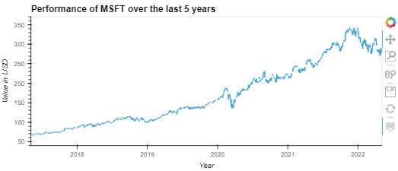
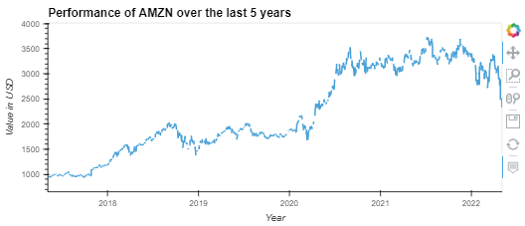
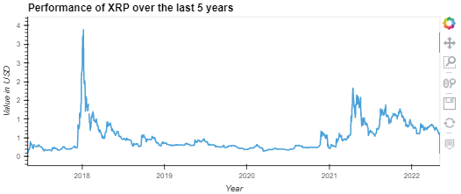
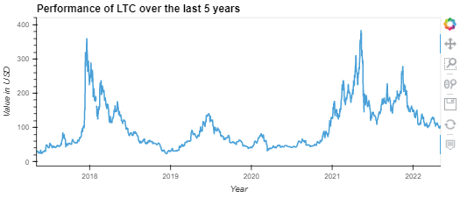
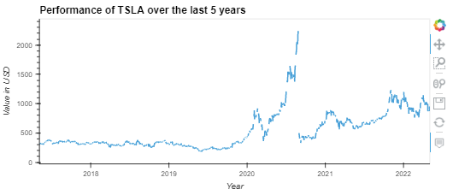
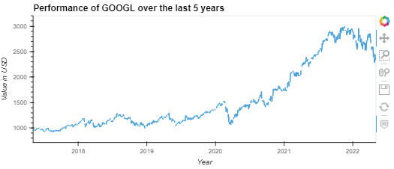
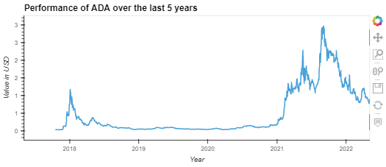
Data Analysis - Performance
Crypto Performance over 5 years
Stock Performance over 5 years
Notes:
Parvinder

Slide 7
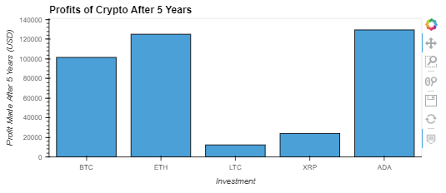
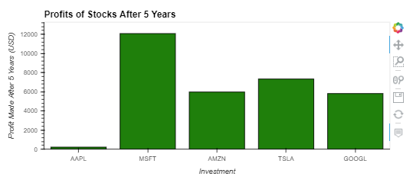
Data Analysis - Returns
Returns in Crypto Assets over 5 years
Returns in Stocks over 5 years
Had Raelyn invested $20,000 equally among Crypto assets and Stocks - 5 years ago – how much returns would she be sitting at?
Notes:
Parvinder

Slide 8
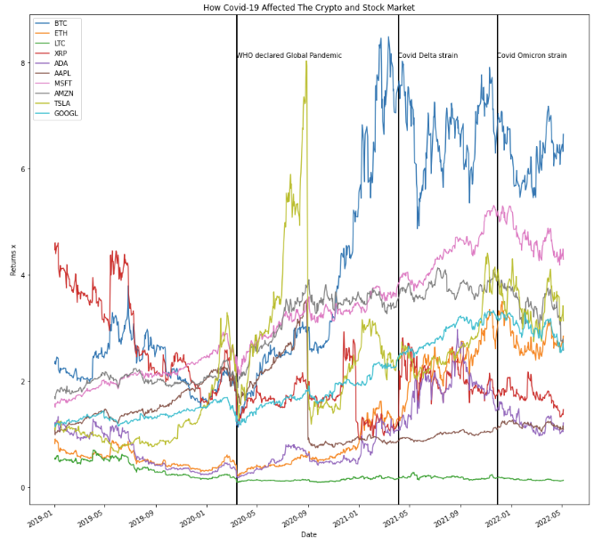
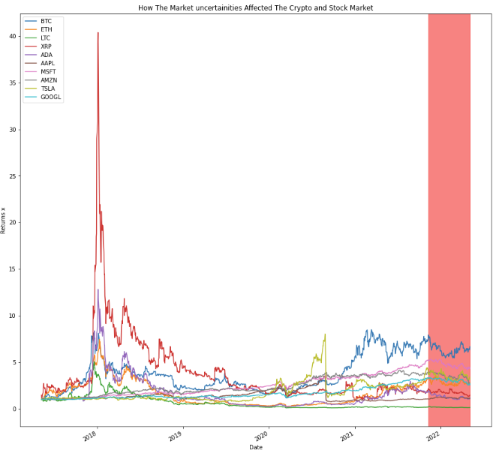
Data Analysis – Volatility (daily returns)
Crypto and Stock Volatility – Major Macro economic factors
Covid
Market Uncertainties
Notes:
Speaker – Raelyn – during covid market crashed – crypto crashed more – however both market recovered afterwards – due to stimulus
Similarly – market uncertainties in last 5-6 months had a negative impact – more so for crypto assets than traditional stocks. Interest rate hike, supply chain issues, war in Ukraine and many other macro economic factors – lead to in confidence in the market

Slide 9
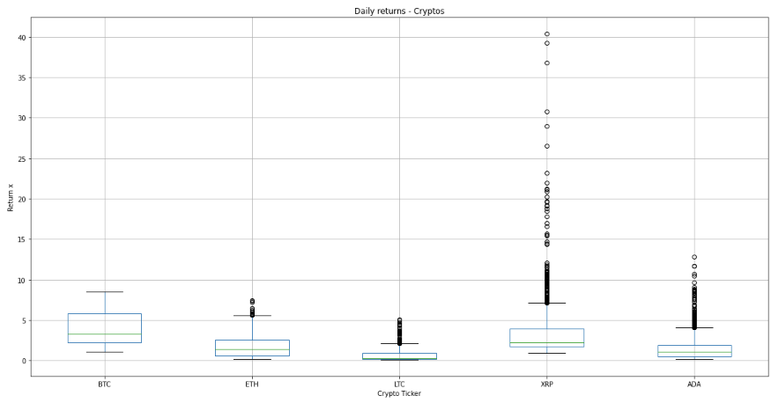
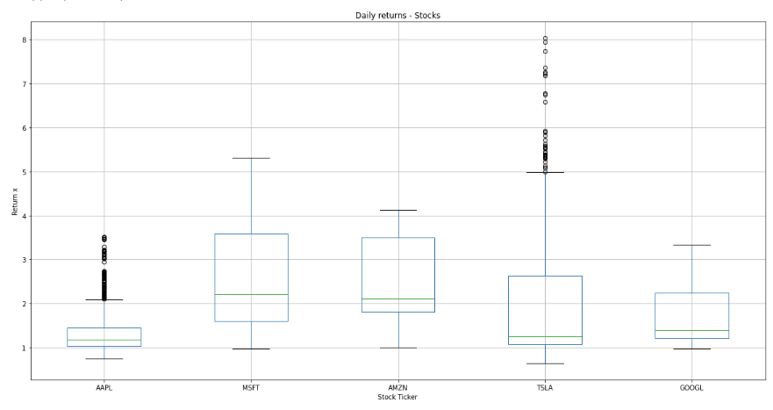
Data Analysis – Standard Deviations
Boxplot - Stocks
Boxplot - Cypto
Notes:
Speaker – Raelyn – Tesla at one point went to 8x returns, and consolidating at 5x, whereas other stocks comparatively had less volatility
Crypto – XRP did 40x before it crashed and is consolidation much lower, most of the other crypto assets did the same – went higher up and consolidating much lower

Slide 10
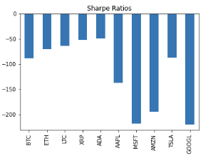
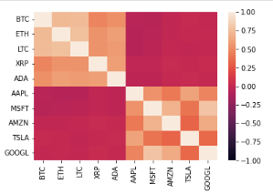
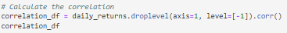
Data Analysis – Risk-free Returns
+ve correlation indicates positive relationship, whereas –ve value shows negative relationship
Sharpe Ratio
Generally, the greater the value of the Sharpe ratio, the more attractive the risk-adjusted return.
Correlation Matrix
Notes:
Speaker – Parvinder – The Sharpe ratio has several weaknesses, including an assumption that investment returns are normally distributed. – Fixed term deposit rate of 0.25%
KEY TAKEAWAYS
The Sharpe ratio adjusts a portfolio’s past performance—or expected future performance—for the excess risk that was taken by the investor.
A high Sharpe ratio is good when compared to similar portfolios or funds with lower returns.
Correlation matrix - , with positive values indicating a positive relationship and negative values indicating a negative relationship.

Slide 11
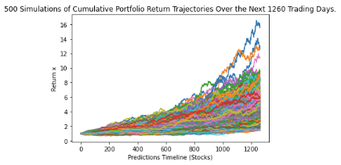
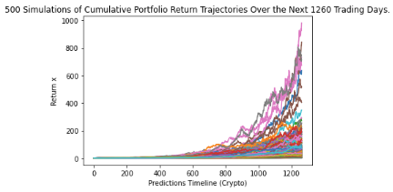
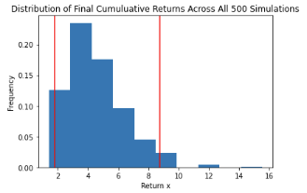
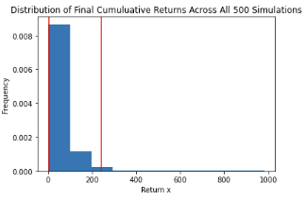
Data Analysis – Monte-Carlo
Stocks
Crypto
Notes:
Speaker – Parvinder – monte-carlo simulation - to estimate the possible outcomes of an uncertain event.

Slide 12
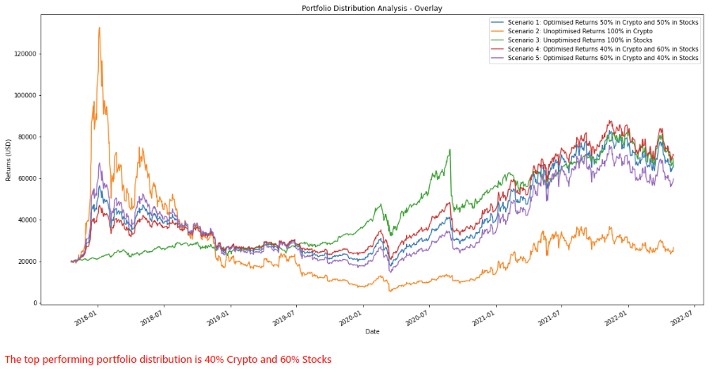
Conclusion– Portfolio Optimization
Notes:
Kurt

Slide 13
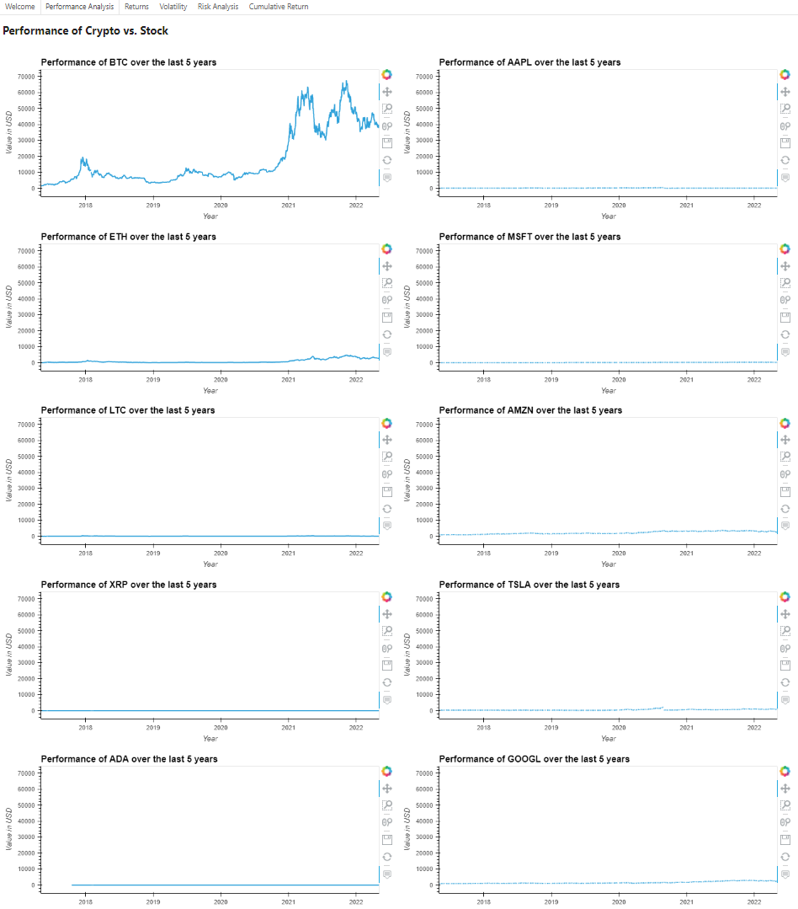
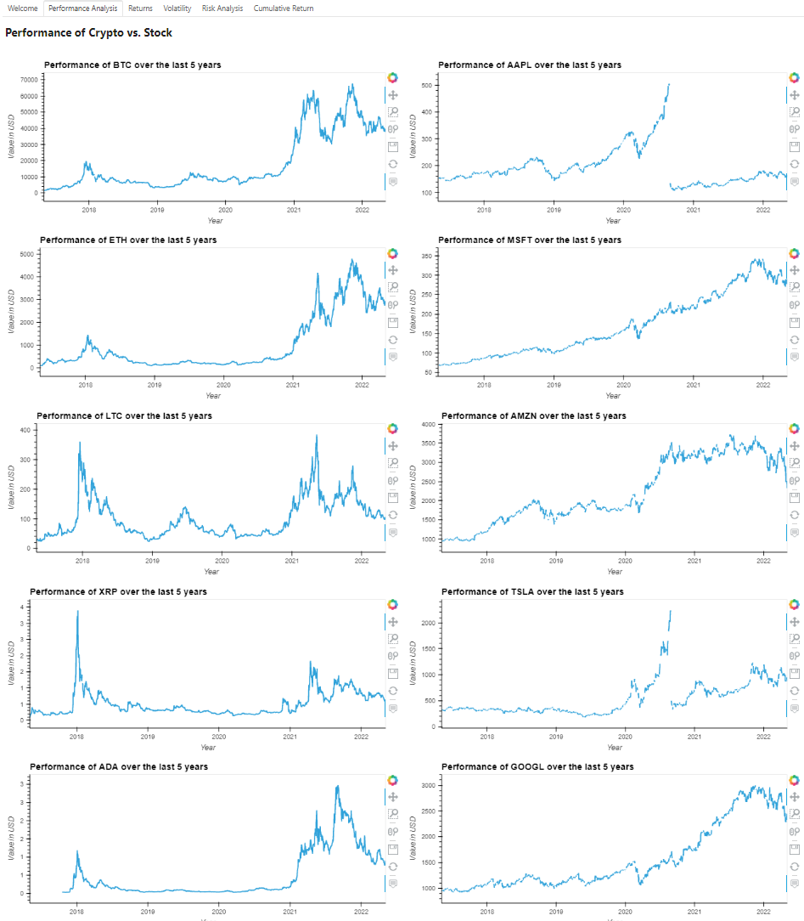
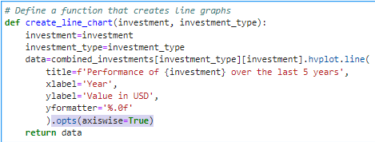
Post-Mortem
Difficulties
Questions
More time in Future
Turnaround time of 2 weeks with a new team
Fetching Data using APIs
Data cleansing
Imbalanced datasets
New library – not discussed in class
Graph Scaling issues in Dashboard
Unsolved GitHub pull and push issues
Minor coding and graphs related questions
Time Series analysis
Interactive Dashboard
Used S&P 500, Gold or Bond data sets for some of our risk free analysis
Recent mayhem in market, isn’t covered
Notes:
Kurt –
Coingecko provided dates in UNIX - As we began cleaning our data for our crypto samples, we noticed that dates were a long string of unknown numbers. We soon found out it was UNIX datetime format
Some crypto weren't old enough - As we began cleaning our data, we noticed that LUNA and SOL were not at least 5 years old. As most of our analysis looked at how our sample had faired over a 5 year period, we needed to change these two crypto out for older ones. We chose LTC and XRP. We then had to extend our data cleaning time.

Slide 14

Do you have any questions?

Slide 15
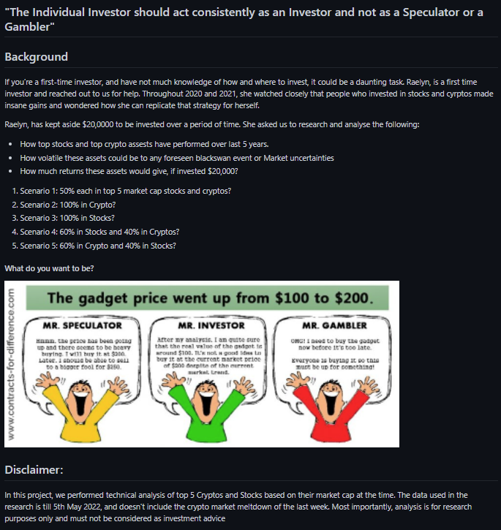
Return
Notes:
Raelyn

